Slide 1
DATA FLOW ARCHITECTURES

Slide 2
STATIC DATA FLOW COMPUTER
Jack dennis and his team at MIT developed a static architecture, known as Dennis machine
Only one data token can occupy an arc at an instant
Static firing rule -> an instruction is enabled if a data token is present on each of its input arcs and no token is present on any of its output arcs
Thus the program graph contains control tokens & data tokens
Control tokens act as acknowledgement signals when data tokens are removed from output arcs

Slide 3
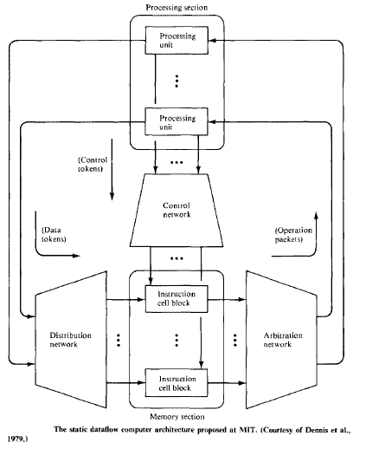

Slide 4
5 major sections
Memory section -> consists of instruction cells which hold instructions & their operands
Processing section -> consists of processing units that perform operations on data tokens
Arbitration network -> delivers operation packets from memory section to the processing section
Control network -> delivers a control token from processing section to the memory section
Distribution network -> delivers data tokens from processing section to the memory section

Slide 5
Instructions held in memory section are enabled for execution by the arrival of their operands in data tokens from distribution n/w & control tokens from control n/w
Enabled instructions together with their operands are sent as operation packets to processing section through arbitration n/w
Result of instruction execution are sent through distribution n/w & control n/w to memory section
Each instruction cell has a unique address, the cell identifier

Slide 6
working
Each instruction cell contain receivers which await the arrival of token values for use as operands by the instruction
Once an instruction cell has received the necessary operand tokens & acknowledgement signals, cell becomes enabled
and sends an operation packet (consisting of instruction & operand values) to the appropriate processing unit through arbitration n/w
Arbitration n/w sorts the operation packets a/c to the operation codes of the instructions they contain

Slide 7
Functions performed by processing unit are distributed among several sections
Operations specified by instructions are carried out in processing section
Control of instruction sequencing is a function of control n/w
Decoding of operation codes is partially done within arbitration n/w

Slide 8
When no. of instruction cells become large , the dennis n/w may become exceedingly large & thus cost prohibitive
One approach to overcome this difficulty is to use the concept of cell blocks

Slide 9
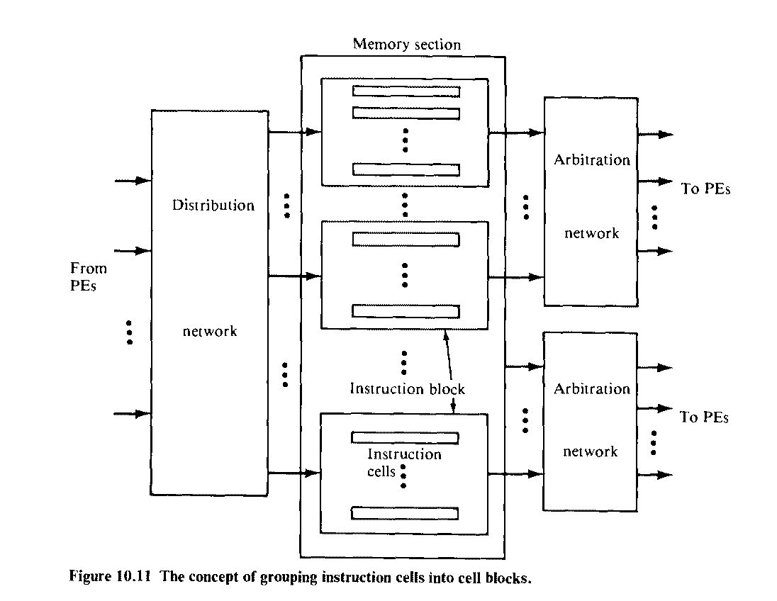

Slide 10
A cell block is a collection of instruction cells which share same set of i/p & o/p ports from distribution, control & arbitration n/w
By using shared I/O ports, the arbitration n/w’s can be partitioned into sub networks of smaller sizes

Slide 11
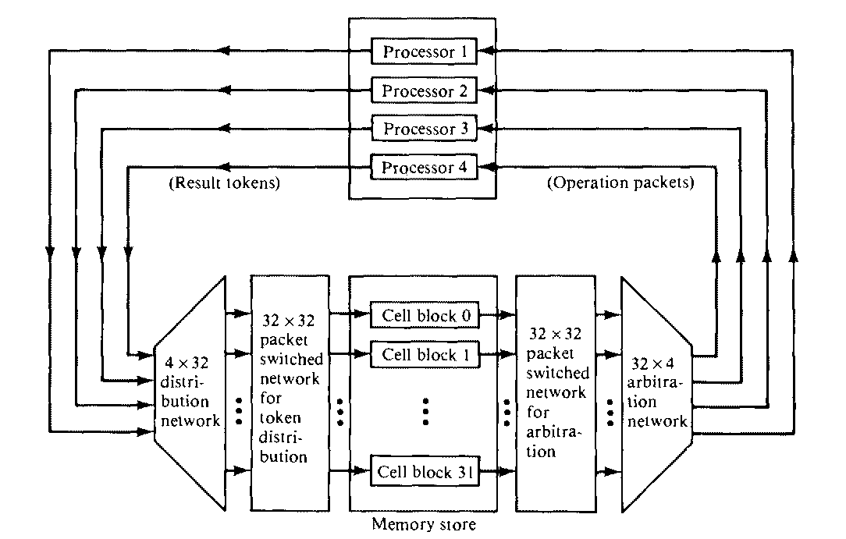
E.g. design of the cell block structured data flow multiprocessor system

Slide 12
System consists of 4 processors & 32 cell blocks
3 building blocks are used to construct 32 *4 arbitration n/w & 4 * 32 distribution n/w
Building blocks are 2 * 1 arbiter, 1 * 2 distributor, 2 * 2 switch & 3 * 2 switch

Slide 13
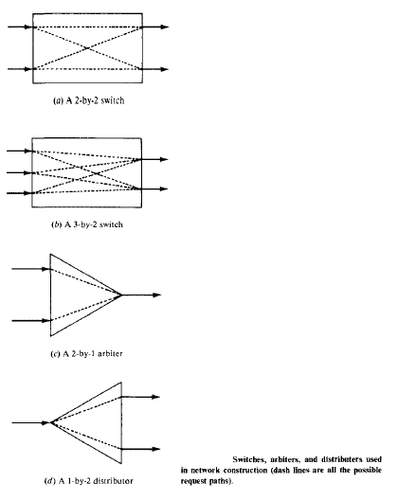
Building blocks

Slide 14
Dynamic data flow computer
Data tokens are tagged (labeled or colored) to allow multiple tokens to appear simultaneously on any input arc of an operator node
No control tokens are needed to acknowledge the transfer of data tokens among instructions
Instead, matching of token tags (labels or colors) is performed to merge them
Therefore, additional h/w is needed to attach tags onto data tokens and to perform tag matching
E.g. systems are Irvin m/c, Arvind m/c, EDDY system, Manchester data flow machine

Slide 15
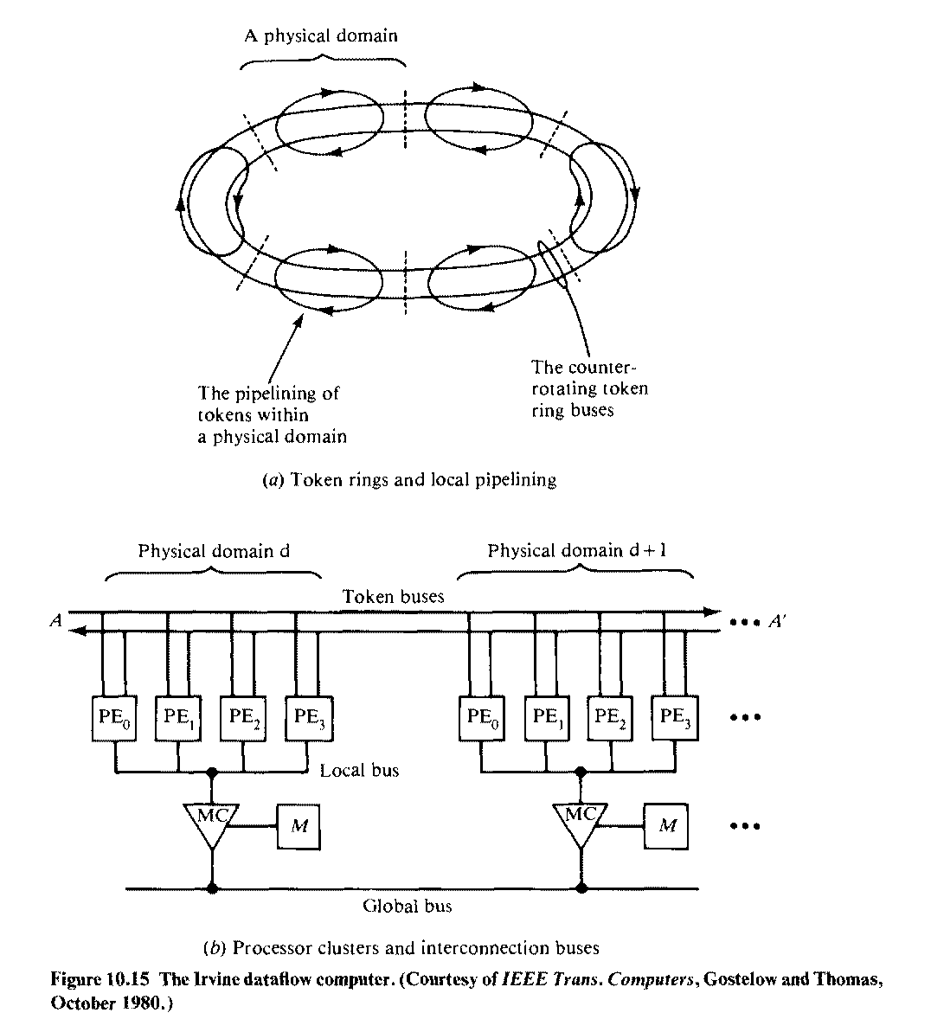
Irvin dataflow computer

Slide 16
Irvine m/c consists of multiple PE clusters
All PE clusters(physical domains) can operate concurrently
PE clusters are interconnected by 2 system buses
Token bus is a pair of bidirectional shift-register rings
Each ring is partitioned into as many slots as there are PE’s
Token rings are used to transfer tagged tokens among PE’s

Slide 17
Each cluster of PE’s (4 PE’s per cluster) shares a local memory through a local bus and a memory controller
A global bus is used to transfer data structures among local memories
Each PE must accept all tokens that are sent to it & sort these tokens into groups
When all i/p tokens for an activity has arrived (Through tag matching), PE must execute that activity

Slide 18
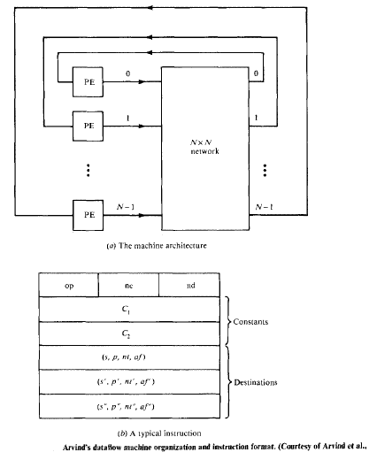
Arvind Machine

Slide 19
Arvind m/c is modified from Irvine m/c
Instead of using token rings, it has chosen to use an N * N packet switch n/w for inter-PE communication
m/c consists of N PE’s, each PE is a complete computer with an instruction set, memory, tag-matching h/w etc
Activities are divided among PE’s

Slide 20
General format of instructions is shown in fig
op -> opcode
nc -> no. of constants stored in the instruction
nd -> no. of destinations for result token
Each destination is identified by 4 fields (s, p, nt, af)
s -> destination address
p -> i/p port at destination address
nt -> no. of tokens need to enable destination instruction
af -> assignment function, used in selecting PE for the execution of destination instruction

Slide 21
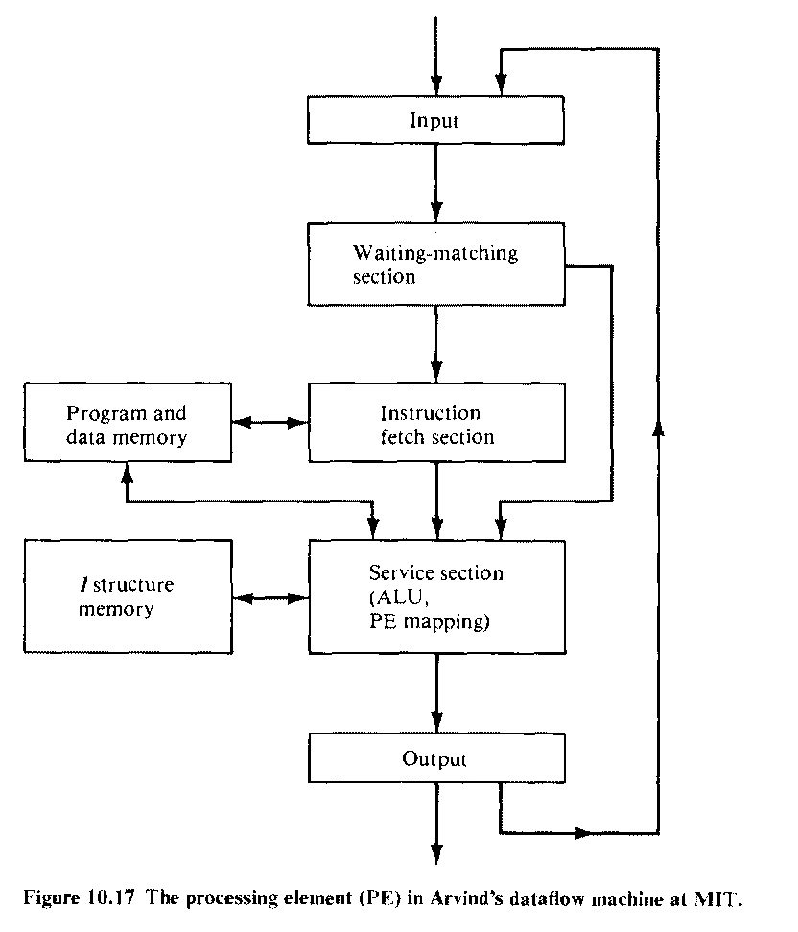
Processing Element (PE) in Arvind m/c

Slide 22
The i/p section has a register which if empty can accept a token
Each activity requires one or two tokens, indicated by nt field
If the activity corresponds to i/p token requires another token, waiting-matching section is informed
Waiting-matching section has a buffer to hold these tokens for which another token with a matching tag has not yet arrived
When the tags of 2 tokens match, both tokens are moved to instruction-fetch buffer

Slide 23
I structure is a special tagged memory for storing array like data structures
Use of array structures avoid excessive array copying
Service section also processes the memory operations
After the ALU produces the result, the result tokens are sent to o/p section

Slide 24
EDDY Dataflow machine
Experimental system for Data Driven processor arraY
consists of 4 * 4 PE’s and 2 broadcast control units (BCU)
Each PE composed of 2 microprocessors (Z80001) and is connected directly with 8 neighboring PE’s
BCU can load or unload programs and data to or from all PE’s at the same time

Slide 25
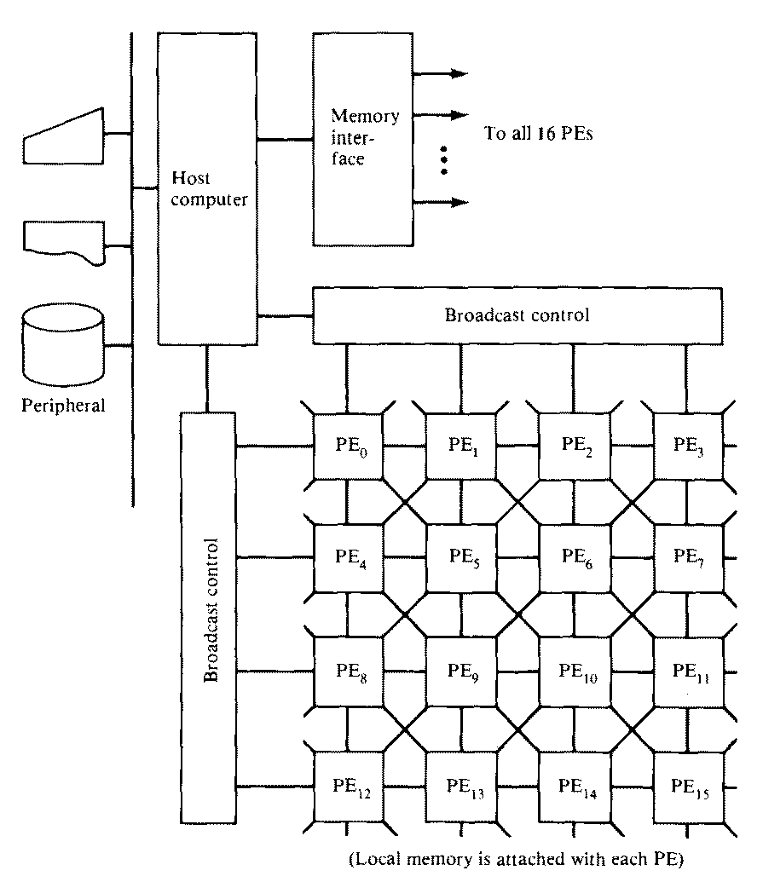
EDDY m/c

Slide 26
Each PE is a circular pipeline consisting of an
instruction memory section
operand memory section,
operation section &
communication section
On arrival of each operand token, instruction memory fetches its operation node & sends both fetched instruction and operand data to operand memory section
If arrived data is an operand for a two-operand operation, operand memory searches for its paired partner

Slide 27
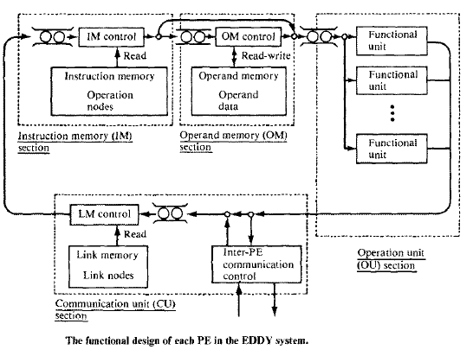
PE in EDDY system

Slide 28
When the paired operand is found, an operation packet is constructed and sent to operation section
When no paired operand is found, the arrived data token is stored in the operand memory with a key attached
All data tokens are tagged so as to allow more than one token to be travelling on an arc
EDDY s/m uses a mixed strategy with static tagging & dynamic tagging
Static tagging -> execution environments are predefined & a unique tag is assigned to each of them
Dynamic tagging -> tags are assigned to each environment dynamically

Slide 29
Operation section consists of several functional units
Communication section consists of final link memory & inter-PE communication controller
This controller sends result packets from other PE’s and transmits them to its own link memory

Slide 30
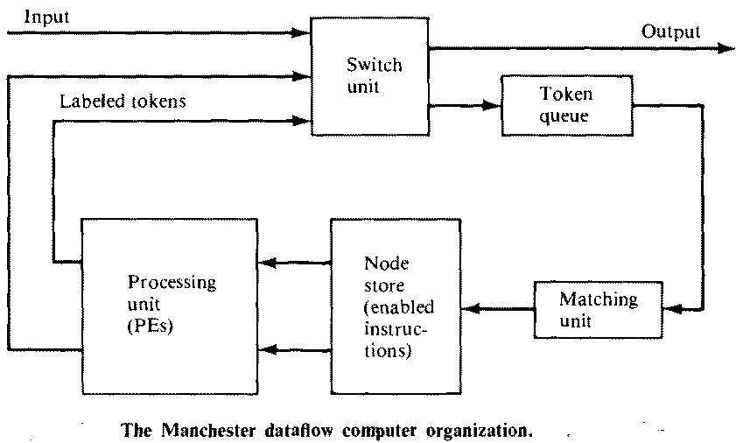
Manchester dataflow m/c

Slide 31
Assumes a ring structure
5 functional blocks communicate in clock-wise direction around a ring
Matching unit groups tokens
When sufficient tokens arrive to fire a node, an appropriate group package finds a destination node in the node store
An executable package (containing operands, operator, pointer to destination node) is sent to processing unit for execution
Switch handles external input/output
Token queue saves excess tokens generated at the same time

Slide 32
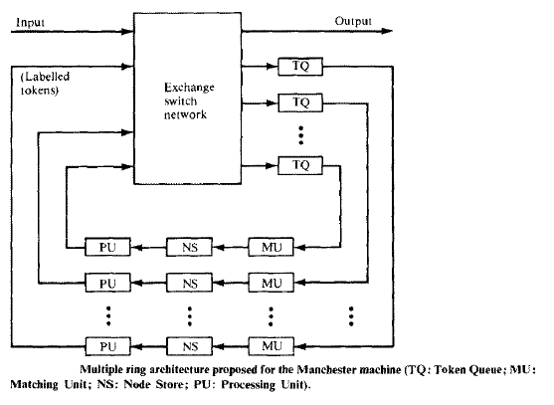
Multiple ring architecture for Manchester m/c
Parallel data-driven rings have been suggested to extend Manchester m/c

